Slide 1



MENTAL HEALTH IN TECH INDUSTRY
An Exploratory Data Analysis by
Rukayat Adeleke
Feeza Sikandar
Alemseghed Ghebrezghi
Gurdhillon Dosanjh
Tsvetan Tsvetkov

Slide 2
Motivation
Entering the field of tech ourselves
Work life in tech more and more competitive
51% of people in tech are diagnosed with mental health disorders according to OSMI* Mental Health in Tech Survey 2016
Spread awareness and drive some changes
Notes:
*Open Sourcing Mental Illness

Slide 3

Source and Data cleanup
The source of the dataset is kaggle.com
The survey is done by Open Sourcing Mental Illness
The data exploration and the cleanup process

Slide 4
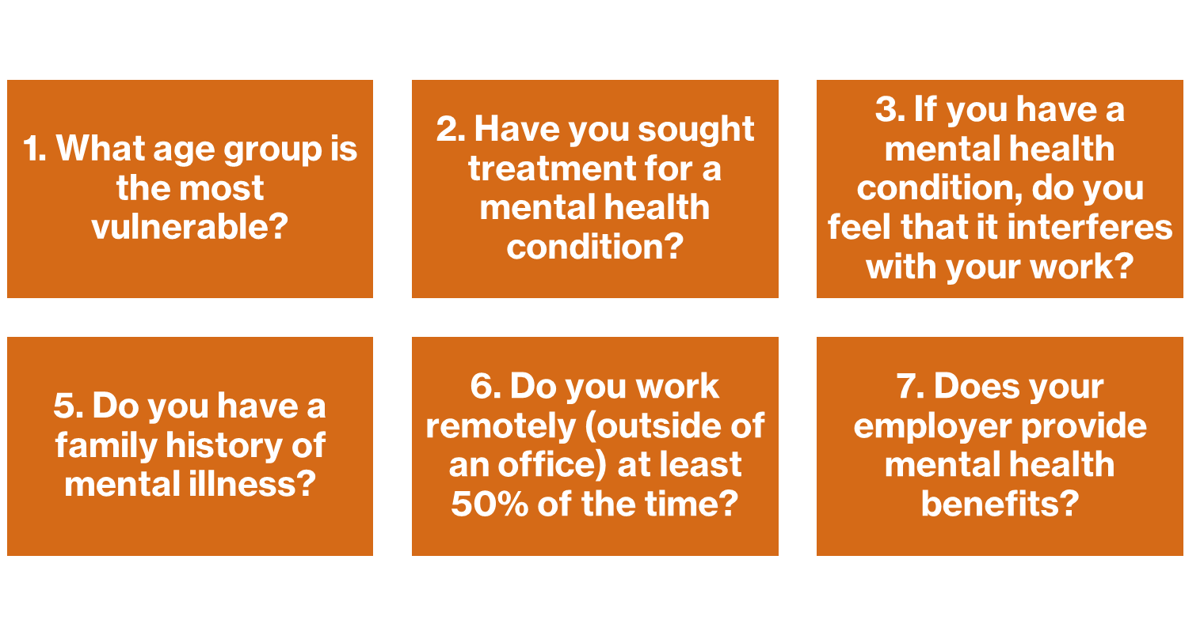
Research Questions

Slide 5
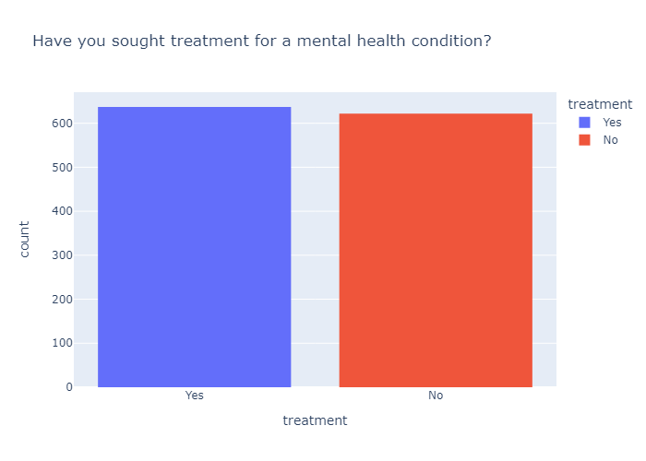
Have you sought treatment for a mental health condition?
Only 50% of people are seeking help.
More needs to be done
so everyone knows that help is available

Slide 6
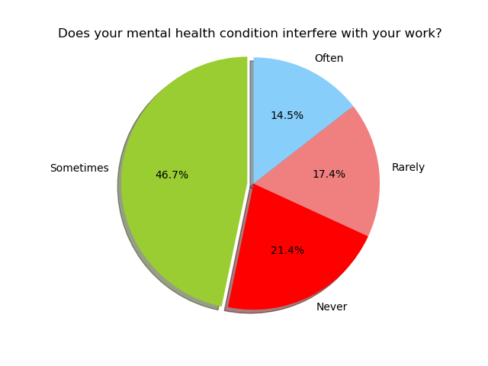
Does your mental health condition interfere with your work?
About 78% of respondents have faced work-interference.

Slide 7
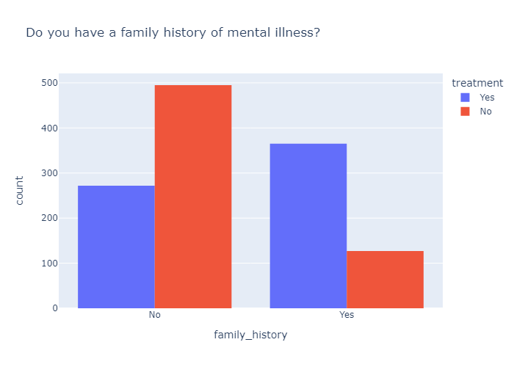
Do you have a family history of mental illness?
Individuals with a family history of mental illness are more inclined to seek treatment.

Slide 8
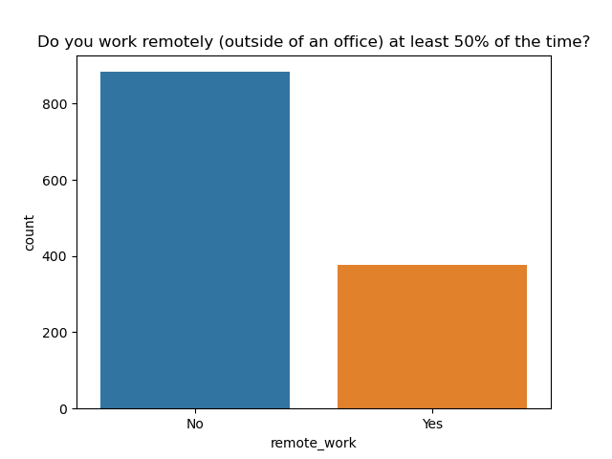
Do you work remotely?
The general insight is that whether people work remotely or not, nearly 50% of them seek treatment.

Slide 9
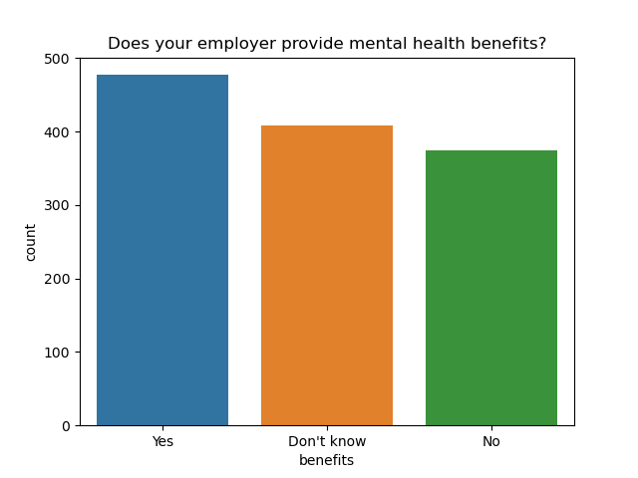
Does your employer provide mental health benefits?
approximately 38% reported that their employer provided mental health benefits.
close to 45% of those who reported not receiving mental health benefits expressed a desire to seek treatment.

Slide 10
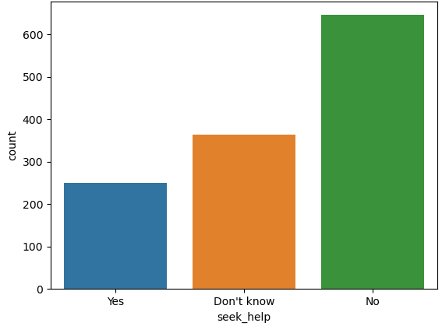
Does your employer provide resources to learn more about mental health issues and how to seek help?
Most companies do not provide mental health resources, or it could be that they do not adequately inform employees about the resources that are available to them.
This highlights the need for HR professionals to focus on providing mental health resources and effectively utilizing any existing resources within the organization.

Slide 11
Conclusion
A lot more needs to be done so the people know of any available treatment.
Most people don’t realize that there is help available to them.
Employers have to do more so their employees know about all the options when it comes to treatment, benefits and other ways to fight mental health illness.

Slide 12

Thank you very much!
It’s time for Feedback and Questions

